Slide 1
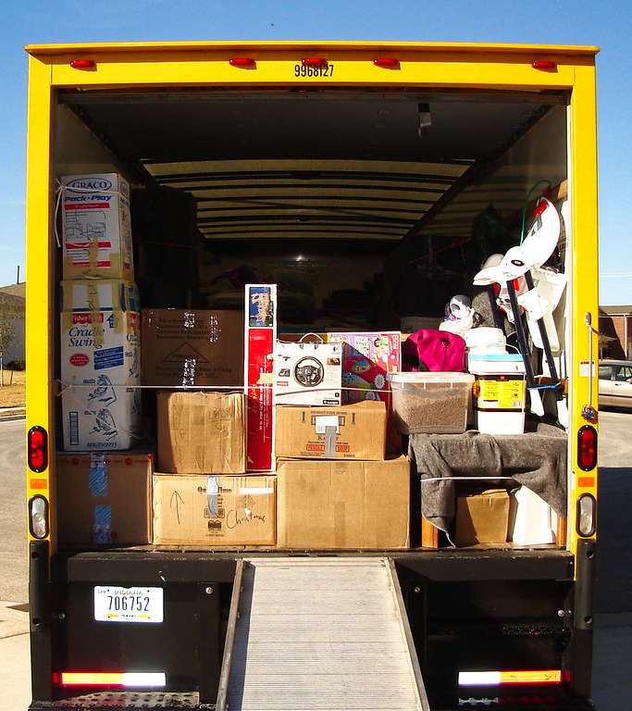
Load.in
Using AI and Computer Vision
to give your move a game plan.
Team Yellow
Prototype Demonstration
Old Dominion University
4/26/2021
Notes:
1

Slide 2
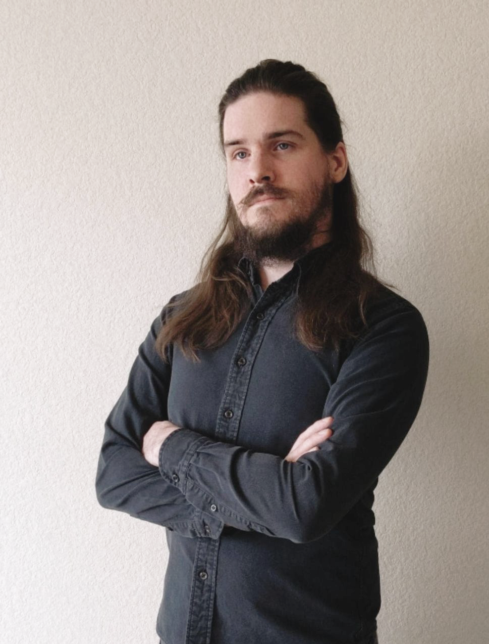

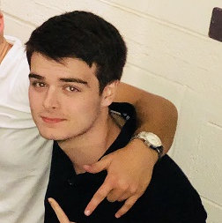




Team Yellow
Jason Moran
Back End Developer
Lance Perdue
Database Developer
Greg Kukanich
Full Stack Developer
Lowell Asher
Mentor
Mitre Corporation
Chris Miller
Full Stack Developer
Paul Rodriguez
Full Stack Developer
Byron Aquilino
Full Stack Developer
4/26/2021
CS 411 – Team Yellow – Load.In – Prototype Demo
2
Notes:
2
Add photo of Lowell and have him introduce himself

Slide 3

The Problem
“Do It Yourself” movers lack the expert knowledge required to handle the logistics of their move.
This Photo by theritemove.com is licensed under CC BY
4/26/2021
CS 410 – Team Yellow – Load.In – Prototype Demo
3
Notes:
3
Societal Problem
Definition
Background information on problem
Customer identified/Case Study

Slide 4
Do It Yourself Moving
Professional movers reduces the time but increases cost
DIY reduces the cost but decreases efficiency
This is where Load.in comes in.
4/26/2021
CS 410 – Team Yellow – Load.In – Prototype Demo
4
Notes:
4
Societal Problem
Definition
Background information on problem
Customer identified/Case Study

Slide 5
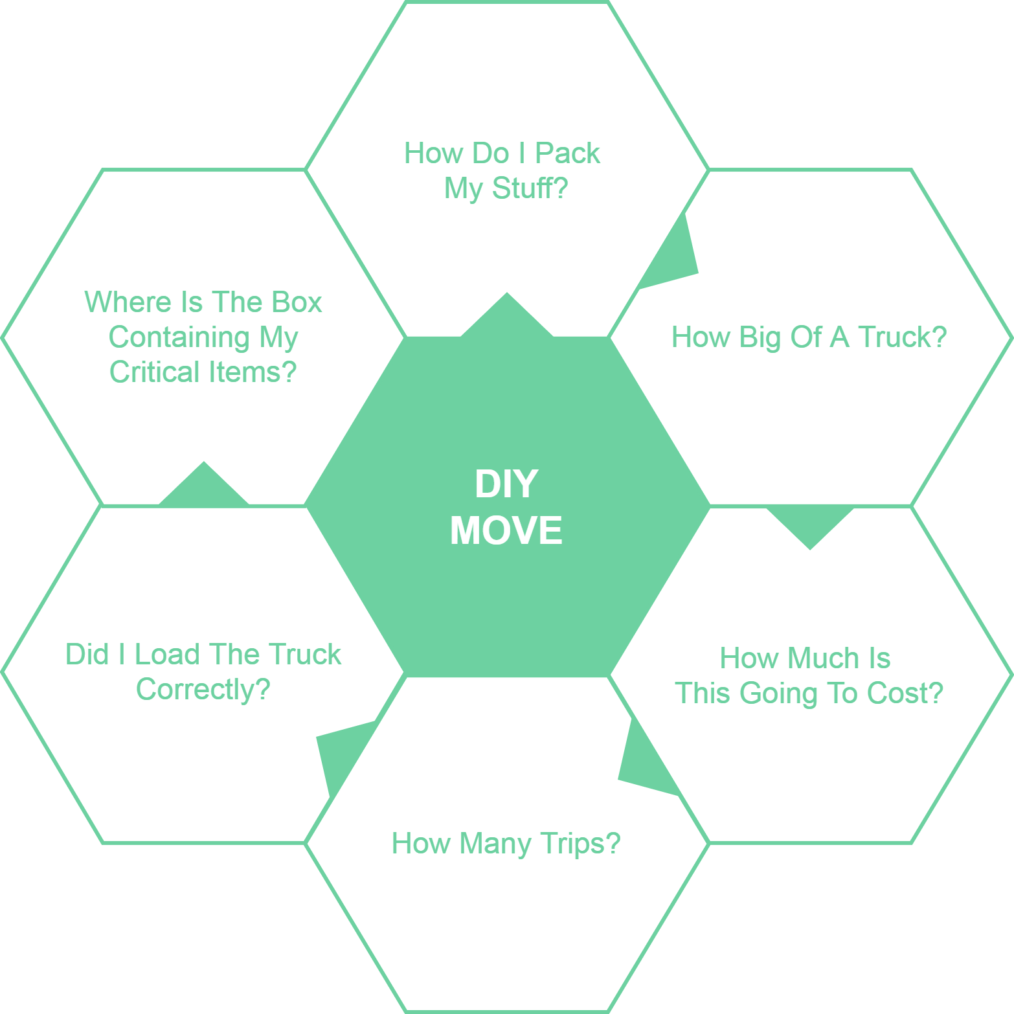
4/26/2021
CS 410 – Team Yellow – Load.In – Prototype Demo
5
Notes:
5
Societal Problem
Definition
Background information on problem
Customer identified/Case Study

Slide 6

Case Study
Family of three:
Two parents
One child
A dog
2200 square foot house
20 miles across town
Too many items to move via pickup truck
CS 410 – Team Yellow – Load.In – Prototype Demo
6

Slide 7
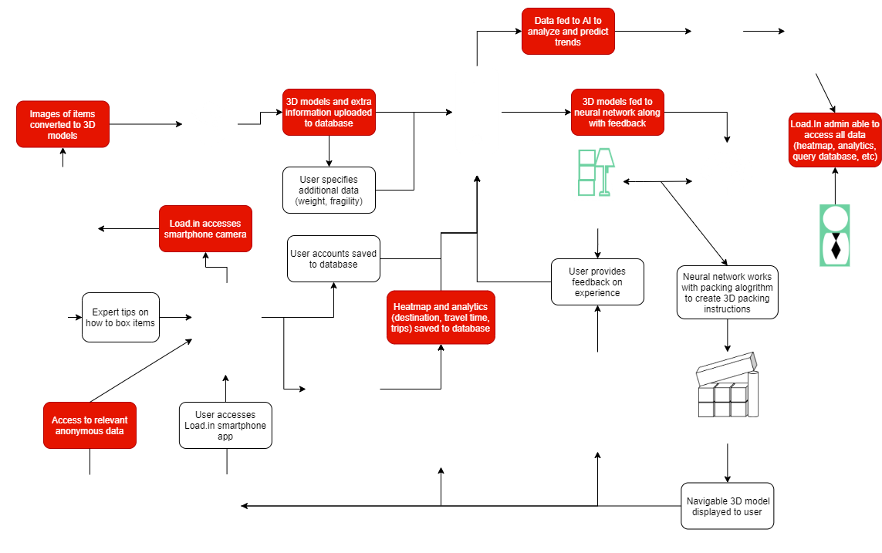
Major Functional Components
4/26/2021
CS 410 – Team Yellow – Load.In – Prototype Demo
7
Notes:
7

Slide 8
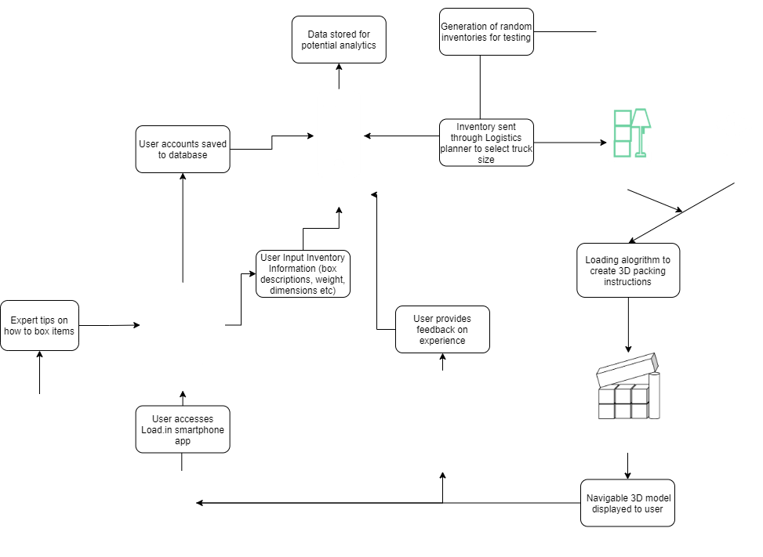
Prototype Major Functional Components
4/26/2021
CS 411 – Team Yellow – Load.In – Prototype Demo
8

Slide 9
Real World Product vs. Prototype Scope
Feature | Real World Product | Prototype
Authentication
Login User Interface | Fully Functional | Fully Functional
User Registration | Fully Functional | Fully Functional
Reset Login | Fully Functional | Eliminated
User Login | Fully Functional | Fully Functional
DIY User Interface | Fully Functional | Fully Functional
Move Inventory:
Furniture/Item measurement | Fully Functional | Partial
3D model generation | Fully Functional | Eliminated
Item weight | Fully Functional | Fully Functional
Item fragility | Fully Functional | Fully Functional
Box locator search feature | Fully Functional | Fully Functional
Load Plan:
Load Plan | Fully Functional | Partial
Truck unloading instructions | Fully Functional | Partial
Logistics Planning:
Estimated number of trips | Fully Functional | Fully Functional
Estimated time to move | Fully Functional | Eliminated
Estimated rental truck costs | Fully Functional | Partial
Feature | Real World Product | Prototype
Expert Help:
Packing Tips & Tricks | Fully Functional | Fully Functional
Tips search | Fully Functional | Fully Functional
Move experts' articles | Fully Functional | Fully Functional
Chatbot | Fully Functional | Eliminated
Live expert | Fully Functional | Eliminated
Vendor Integration/Data Import:
3rd party vendor web scraper | Fully Functional | Eliminated
3rd party vendor web API reader | Fully Functional | Eliminated
Box dimensions | Fully Functional | Eliminated
Truck sizes | Fully Functional | Partial
Truck availability | Fully Functional | Eliminated
Analytics:
Location data | Fully Functional | Partial
Move data | Fully Functional | Partial
Feedback data | Fully Functional | Partial
Heatmap | Fully Functional | Eliminated
Rental interest statistics | Fully Functional | Eliminated
Tips & Tricks Search Analytics | Fully Functional | Partial
Notes:
Color code the MFCD and prototype MFCD to show how the prototype morphs and then have the real world product vs prototype scope table for after these. Change estimated time to move to partial implementation and add row under expert help to save unmatched expert tips searches into the database. Make a tip for a golden retriever.

Slide 10
Risks
Risks
Customer
C-1: End users are not satisfied with the recommendations of the application.
C-1 Mitigation: Implement a customer feedback feature that allows the users to disclose his/her issues with the applications.
C-2: End user doesn’t follow the guidelines of the application.
C-2 Mitigation: Implement a feature that allows the user to repeat certain steps in the application as they progress.
Probability
 |  | Very Low | Low | Medium | High | Very High
Severity | Very High
 | High
 | Medium |  |  | C-1
 | Low |  | S-1 S-2 |  | C-2
 | Very Low
Security
S-1: End user want to ensure the pictures taken of personal information doesn’t fall into the wrong hands.
S-1 Mitigation: No need to worry, this feature isn’t a thing.
S-2: End user wants to ensure his/her data isn’t being collected for nefarious purposes.
S-2 Mitigation: For the prototype, the only information stored is given by the user for the purposes of the move inventory and can be deleted at any time via test harness.
4/26/2021
CS 410 – Team Yellow – Load.In – Prototype Demo
10
Notes:
10

Slide 11
Technical Risks
Probability
 |  | Very Low | Low | Medium | High | Very High
Severity | Very High |  |  |  |  | T-1
 | High |  |  |  | T-2
 | Medium |  |  | T-3
 | Low
 | Very Low
T-1: Current technology involving computer vision is a challenge.
T-1 Mitigation: Conduct a prototype to mitigate risk of critical errors upon release.
T-2: Artificial Intelligence prone to error due to insufficient training data.
T-2 Mitigation: Implementing a feedback loopback in the beta phase with test users.
T-3: Challenge to obtain accurate and timely feedback.
T-3 Mitigation: Implement a feature for users to give feedback if the application operated correctly after completing a move.
4/26/2021
CS 410 – Team Yellow – Load.In – Prototype Demo
11
Notes:
11

Slide 12
Prototype Demonstration
Registration & Login
Presenter: Chris
Expert Tips & Tricks
Presenter: Paul and Lance
Move Inventory
Presenter: Chris and Greg
Logistics Planner
Presenter: Paul
Load Plan Navigator
Presenter: Jason and Byron
Case Study
Presenter: Chris
Random Move Inventory
Presenter: Jason
Tour of Backend
Presenter: Byron and Lance
Q&A
Assumptions:
Everything is a box (only support width, height and length)
Boxes that are too big won’t go on the truck
No rotation in load plan generation
3 trips per day used to calculate daily truck rental costs
Dev Environment:
Ubuntu
Virtual Machines
Docker
Android Studio
Virtual Phone Device
4/26/2021
CS 411 – Team Yellow – Load.In – Prototype Demo
12

Slide 13
Future Plans
Photogrammetry for box measurements
Load Plan – Rotation
Load Plan Generation as a Background Service
Sharing Load Plans between devices
Analytics
Vendor Synchronization
4/26/2021
CS 411 – Team Yellow – Load.In – Prototype Demo
13

Slide 14

14
Notes:
14

